Slide 1


Noida Institute of Engineering and Technology, Greater Noida
Project Scheduling and Network Analysis
Unit: IV
Project Management
AOE0761
Harshit thakur
Assistant Professor
CSE
BTECH 4TH YEAR VII Semester

Slide 2
Index/Content
S. No. | Index
1. | Name of Subject with code, Course and Subject Teacher
2. | Brief Introduction of Faculty member with Photograph
3. | Evaluation Scheme
4. | Syllabus
5. | Branch wise Application
6. | Course Objective(s)
7. | Course Outcome(s)
8. | Program Outcomes (POs)
9. | COs and POs Mapping
Harshit Thakur Unit_4

Slide 3
Index/Content
S. No. | Index
10. | Program Specific Outcomes (PSOs)
11. | Cos and PSOs Mapping
12. | Program Educational Objectives (PEOs)
13. | Result Analysis
14. | End Semester Question paper Templates
15. | Prequisite/Recap
16. | Brief Indtroduction about the Subject with Videos
17. | Unit Contents
18. | Unit Objectives
19. | Topic Objectives/Topic Outcome
Harshit Thakur Unit_4

Slide 4
Index/Content
S. No. | Index
20. | Lecture related to topic
21. | Daily Quiz
22. | Weekly Assignment
23. | Topic Links
24. | MCQs
25. | Glossary Questions
26. | Old question papers
27. | Expected Questions
28. | Recap of unit
Harshit Thakur Unit_4

Slide 5
Faculty Profile
Faculty Name: Harshit Thakur
Designation: Assistant Professor
Department: CSE
Email ID: harshit.thakur@niet.co.in
Qualification: M.Tech, B.Tech
Specialisation: CSE
Research Area: Cloud Computing
Total Experience: 1 Year
Harshit Thakur Unit-1

Slide 6
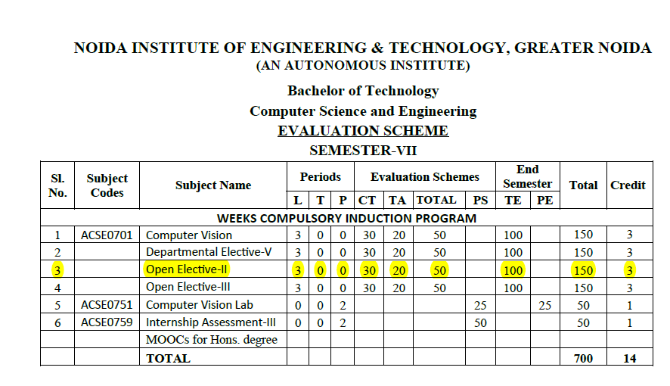
Evaluation Scheme
Harshit Thakur Unit-1

Slide 7
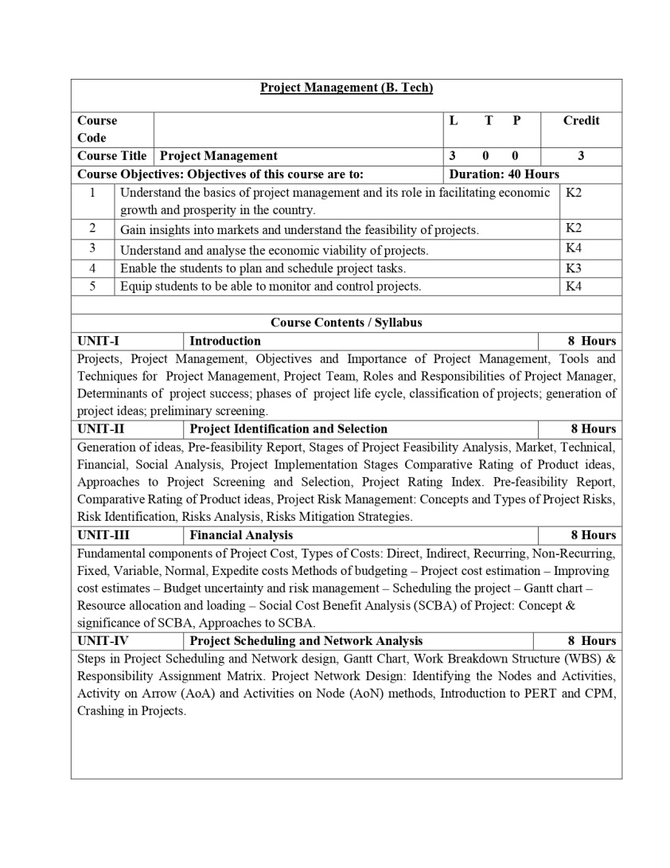
Syllabus
Harshit Thakur Unit-1

Slide 8
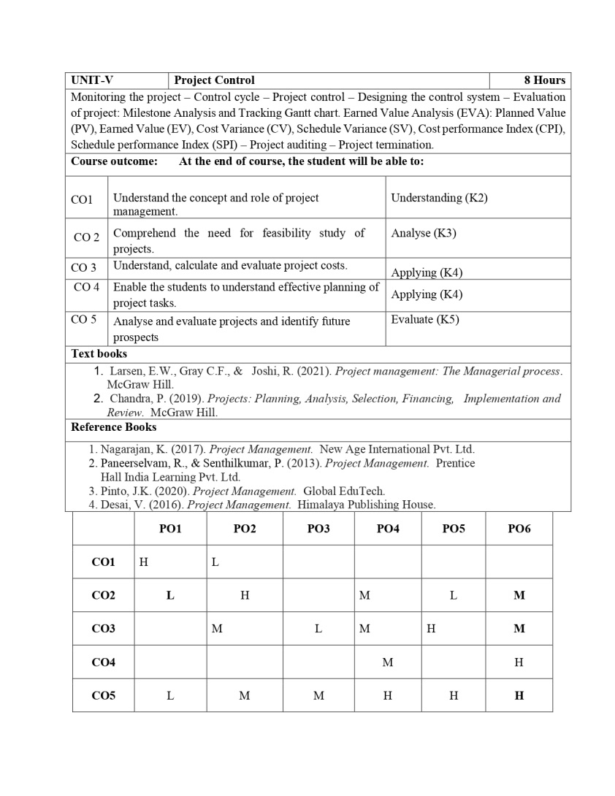
Syllabus
Harshit Thakur Unit-1

Slide 9
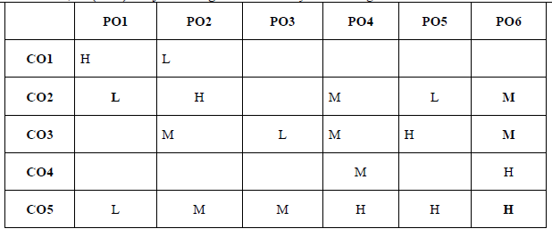
CO-PO Mapping
*1=High, *2=Medium, *3=Low
Maneesh Kumar Unit 1
Harshit Thakur Unit_4

Slide 10
Prerequisites
1. Basic Project Management Knowledge:
2. Understanding of Project Scope and Objectives:
3. Task and Activity Identification:
4. Mathematical and Analytical Skills:
5. Risk Management Understanding:
6. Familiarity with Project Management Software:
7. Effective Communication Skills:
8. Critical Thinking and Problem-Solving Skills:
9. Knowledge of Business and Organizational Context:
10. Experience in Project Execution:
Harshit Thakur Unit_4

Slide 11
Content
Steps in Project Scheduling and Network design, Gantt Chart, Work Breakdown Structure (WBS) & Responsibility Assignment Matrix. Project Network Design: Identifying the Nodes and Activities, Activity on Arrow (AoA) and Activities on Node (AoN) methods, Introduction to PERT and CPM, Crashing in Projects.
Harshit Thakur Unit_4

Slide 12
Course Outcome
CO1: Understand the concept and role of project management.
CO2: Comprehend the need for a feasibility study of projects.
CO3: Understand, calculate, and evaluate project costs.
CO4: Enable the students to understand effective planning of project tasks.
CO5: Analyse and evaluate projects and identify future prospects
Harshit Thakur Unit_4

Slide 13
Introduction
Definition of Project Scheduling and Network Analysis:
  Project scheduling involves the processes of defining, sequencing, estimating, and developing the project schedule.
  Network analysis refers to the techniques used to plan, monitor, and control projects.
Importance in Project Management:
  Ensures projects are completed on time, within budget, and meet quality standards.
  Provides a visual representation of project tasks and their dependencies.
  Facilitates effective resource allocation and management.
Harshit Thakur Unit_4
Notes:
What you mean by project identification, in hindi, how to find out effective project (youtube link)
https://www.youtube.com/watch?v=gHisxz1BskA

Slide 14
Steps in Project Scheduling
Project scheduling in software project management involves a series of steps to plan, organize, and allocate resources effectively to ensure timely project completion. Here are the steps involved in project scheduling specifically tailored for software projects:
1. Define Project Scope:
Clearly define the project's objectives, deliverables, constraints, and assumptions.
Understand the client's requirements and expectations regarding the software product.
2. Create a Work Breakdown Structure (WBS):
Decompose the project into smaller, manageable tasks and create a hierarchical WBS.
Divide software development into phases (requirements, design, development, testing, deployment) and further into specific tasks.
3. Identify Tasks and Activities:
Break down the WBS into specific tasks and activities related to software development.
Identify tasks such as requirements gathering, system design, coding, testing, and documentation.
4. Sequence Tasks and Activities:
Determine the logical order of tasks and activities. Some tasks can only start after others are completed.
Define dependencies between tasks (finish-to-start, start-to-start, finish-to-finish, start-to-finish) based on task requirements.
5. Estimate Task Durations:
Estimate the time required for each task. Use historical data, expert judgment, or analogous estimation methods.
Involve team members to provide input on task durations based on their expertise.
6. Allocate Resources:
Identify the human resources, software, hardware, and facilities needed for each task.
Allocate resources based on task requirements, team members' skills, and availability.
Harshit Thakur Unit_4

Slide 15
Steps in Project Scheduling
7. Develop a Project Schedule:
Use scheduling tools or software (e.g., Microsoft Project) to create a detailed project schedule.
Include task names, start and end dates, task durations, dependencies, and assigned resources.
8. Define Milestones:
Identify key milestones in the software development process, such as completion of requirements gathering, prototype development, beta testing, etc.
Milestones serve as progress markers and help in tracking the project's overall timeline.
9. Risk Assessment and Contingency Planning:
Identify potential risks associated with the project schedule, such as unexpected technical challenges or resource unavailability.
Develop contingency plans to address potential risks and mitigate their impact on the schedule.
10. Regular Monitoring and Adjustments:
Continuously monitor the project progress against the planned schedule.
Make adjustments as necessary, such as reassigning tasks, adjusting timelines, or acquiring additional resources, to keep the project on track.
11. Communication and Collaboration:
Maintain open communication channels with team members, stakeholders, and clients.
Foster collaboration to ensure everyone is aware of the project schedule and their respective responsibilities.
12. Documentation:
Document the project schedule, including task details, resource assignments, dependencies, and milestones.
Keep the documentation updated as the project progresses and changes occur.
Harshit Thakur Unit_4

Slide 16
Steps in Network Design
Network design in software project management involves creating a visual representation of the project tasks, their dependencies, and the flow of work. This helps project managers and team members understand the sequence of activities and ensure the project progresses efficiently. Here are the steps in network design specifically tailored for software projects:
1. Identify Project Tasks and Activities:
List down all the tasks and activities involved in the software project, including requirements gathering, design, coding, testing, documentation, and deployment.
Break down tasks into smaller activities or sub-tasks to provide granularity in the network diagram.
2. Determine Task Dependencies:
Identify the relationships between tasks. Determine which tasks are dependent on the completion of others.
Use dependency types: Finish-to-Start (most common), Start-to-Start, Finish-to-Finish, and Start-to-Finish.
3. Create a Precedence Diagram:
Represent tasks and their dependencies graphically using a Precedence Diagram Method (PDM). Nodes represent tasks, and arrows represent dependencies.
Clearly indicate the direction of the task dependencies to show the sequence of activities.
4. Identify the Critical Path:
Calculate the critical path, which is the longest sequence of tasks determining the project's minimum duration.
Tasks on the critical path have zero slack or float, meaning any delay in these tasks will directly impact the project's timeline.
5. Use Network Diagramming Software:
Utilize specialized project management software or tools that offer features for creating network diagrams.
Popular tools include Microsoft Project, Primavera P6, and various online project management platforms.
Harshit Thakur Unit_4

Slide 17
Steps in Network Design
6. Include Milestones and Deliverables:
Identify project milestones, such as completion of a development phase or client review meetings.
Clearly mark these milestones on the network diagram to highlight significant project events.
7. Consider Resource Constraints:
Take into account the availability and allocation of resources when defining task dependencies.
Avoid overloading resources at specific project stages to maintain a balanced workflow.
8. Validate the Network Diagram:
Review the network diagram with project team members and stakeholders to ensure accuracy and completeness.
Address any feedback or concerns and make necessary adjustments to the diagram.
9. Regularly Update the Network Diagram:
Keep the network diagram up-to-date as the project progresses. As tasks are completed, dependencies might change.
Regularly review and adjust the network diagram to reflect the current project status accurately.
10. Communicate the Network Diagram:
Share the network diagram with the project team, stakeholders, and clients.
Ensure everyone involved understands the flow of work, task dependencies, and the critical path.
11. Integrate Network Design with Project Scheduling:
Integrate the network diagram with the overall project schedule, which includes task durations, start and end dates, and resource assignments.
Ensure consistency between the network diagram and the project schedule for accurate project planning and execution.
Harshit Thakur Unit_4

Slide 18
Gantt Chart
A Gantt chart is a widely used tool in software project management that provides a graphical representation of a project schedule. It shows the start and finish dates of various elements of a project, allowing project managers to track progress, allocate resources, and plan for future tasks. Gantt charts are valuable for visualizing project timelines, dependencies between tasks, and the overall project schedule.
Key Components of a Gantt Chart:
Tasks/Activities: List of all the tasks or activities that need to be completed for the project.
Timeline: Horizontal axis representing the project timeline. It can be in days, weeks, months, etc.
Bars: Bars represent tasks on the chart. The length of the bar indicates the duration of the task. Tasks can be displayed sequentially or in parallel based on their dependencies.
Dependencies: Relationships between tasks, often represented by lines connecting task bars. Dependencies can be of different types, such as finish-to-start, start-to-start, finish-to-finish, or start-to-finish.
Milestones: Significant points or achievements in the project. They are usually represented as diamond-shaped markers on the chart.
Harshit Thakur Unit_4

Slide 19
Steps to Create a Gantt Chart:
Identify Tasks: List down all the tasks or activities that need to be completed for the project. Be specific and detailed about each task.
Estimate Durations: Estimate the time required to complete each task. This could be in days, weeks, or any other unit of time relevant to your project.
Sequence Tasks: Determine the order in which tasks need to be completed. Identify dependencies between tasks (which tasks need to be finished before others can start).
Create the Chart: Using software tools like Microsoft Project, Excel, or specialized project management software, create the Gantt chart. Input task names, start dates, and durations to generate the chart.
Add Dependencies: Indicate task dependencies using lines connecting the bars. This shows which tasks are dependent on the completion of others.
Include Milestones: If your project has significant milestones, add them to the chart as diamond-shaped markers.
Adjust and Update: As the project progresses, update the chart to reflect the actual start and finish dates. Adjust the chart for any changes in task duration or dependencies.
Harshit Thakur Unit_4

Slide 20
Gantt Chart and RAM
Task | Duration (weeks) | Start Date | End Date | Dependencies
Requirements | 2 | 01/01/2023 | 01/14/2023 | None
Design | 3 | 01/15/2023 | 02/04/2023 | Requirements
Frontend Development | 4 | 02/05/2023 | 03/04/2023 | Design
Backend Development | 4 | 02/05/2023 | 03/06/2023 | Design
Testing | 2 | 03/05/2023 | 03/18/2023 | Frontend, Backend
Deployment | 1 | 03/19/2023 | 03/25/2023 | Testing
Harshit Thakur Unit_4

Slide 21
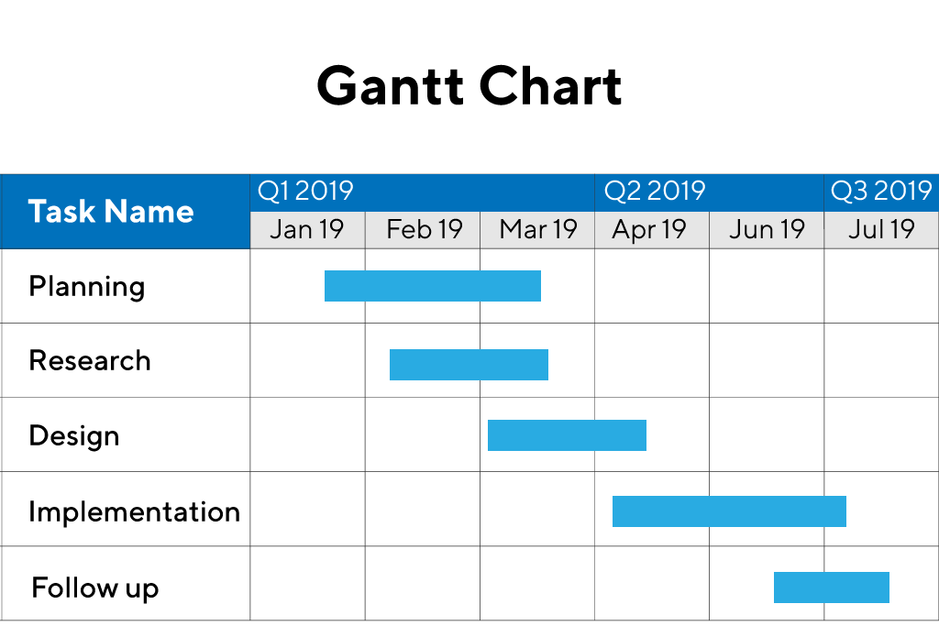
Example of Gantt Chart
Harshit Thakur Unit_4

Slide 22
Work Breakdown Structure (WBS)
Definition of WBS:
  Hierarchical decomposition of the total scope of work to be carried out by the project team.
  Helps in organizing and defining the total scope of the project.
Importance in Project Planning:
  Provides a clear and visual representation of project tasks.
  Helps in effective resource allocation and task assignment.
  Facilitates better understanding of the project's structure and objectives.
Example of WBS for a Software Project:
    Project Management
    1.1 Project Planning
    1.2 Risk Management
    Software Development
    2.1 Requirement Analysis
    2.2 Design
    2.3 Coding
    2.4 Testing
    Deployment
    3.1 User Training
    3.2 System Deployment
Harshit Thakur Unit_4

Slide 23
Work Breakdown Structure (WBS)
The Work Breakdown Structure (WBS) is a fundamental project management tool used to define and organize the total scope of a project into manageable pieces. In software project management, a WBS is particularly useful for breaking down complex software development tasks into smaller, more manageable components. It provides a clear and detailed framework for understanding the project's scope, planning activities, and organizing resources efficiently.
Components of a Work Breakdown Structure:
Project: The highest level of the WBS represents the entire software project.
Phases: Major project phases, often representing significant milestones or stages in the software development life cycle. Examples include Planning, Requirements, Design, Development, Testing, Deployment, and Maintenance.
Tasks: Subdivisions of phases, representing specific activities or work packages within each phase. For example, in the Development phase, tasks could include Frontend Development, Backend Development, Database Design, etc.
Sub-Tasks: Further breakdown of tasks into smaller, actionable items. Sub-tasks are often assigned to specific team members or groups. For example, in Frontend Development, sub-tasks might include User Interface Design, Navigation Implementation, etc.
Harshit Thakur Unit_4

Slide 24
Steps to Create a Work Breakdown Structure (WBS) for a Software Project:
Define Project Objectives: Clearly understand the project's goals and what needs to be achieved.
Identify Major Phases: Determine the major phases of the software development life cycle that the project will go through. These could include Planning, Analysis, Design, Implementation, Testing, Deployment, and Maintenance.
Break Down Phases into Tasks: For each phase, identify the tasks or activities required. For instance, in the Implementation phase, tasks could include Frontend Development, Backend Development, Database Design, etc.
Identify Sub-Tasks: Break down tasks further into manageable sub-tasks. For example, under Frontend Development, sub-tasks could include User Interface Design, Navigation Implementation, and Form Validation.
Assign Responsibility: Assign responsibility for each task and sub-task to specific team members or groups. This ensures accountability for completion.
Estimate Time and Resources: Estimate the time and resources required for each task and sub-task. This helps in project scheduling and resource allocation.
Create the WBS: Organize the tasks, sub-tasks, and phases hierarchically, creating a visual representation of the project's structure.
Harshit Thakur Unit_4

Slide 25
Example of a Work Breakdown Structure (WBS) for a Software Project:
Project: E-commerce Website Development
Phase 1: Planning
- Task 1: Project Kickoff Meeting
- Task 2: Requirement Analysis
- Task 3: Project Planning and Scheduling
Phase 2: Design
- Task 1: User Interface Design
- Task 2: Database Design
- Task 3: Wireframing and Prototyping
Phase 3: Development
- Task 1: Frontend Development
- Sub-Task 1: Homepage Design
- Sub-Task 2: Product Page Implementation
- Task 2: Backend Development
- Sub-Task 1: Database Integration
- Sub-Task 2: API Development
Phase 4: Testing
- Task 1: Unit Testing
- Task 2: Integration Testing
- Task 3: User Acceptance Testing
Phase 5: Deployment and Maintenance
- Task 1: Deployment to Hosting Server
- Task 2: Bug Fixing and Updates
Harshit Thakur Unit_4

Slide 26
Advantages of Using a WBS in Software Project Management:
Clarity: Provides a clear and structured view of the project, making it easier to understand and manage.
Effective Planning: Helps in planning tasks, resources, and schedules more accurately.
Resource Allocation: Facilitates efficient allocation of resources by breaking down tasks into manageable components.
Communication: Improves communication among team members, stakeholders, and project managers, ensuring everyone understands their roles and responsibilities.
Progress Tracking: Enables easy tracking of project progress by comparing the completed work against the planned WBS.
Risk Management: Helps identify potential risks and dependencies, allowing for better risk management strategies.
Harshit Thakur Unit_4

Slide 27
Responsibility Assignment Matrix
A Responsibility Assignment Matrix (RAM), also known as a RACI chart or matrix, is a project management tool used to clarify the roles and responsibilities of team members involved in a project. RAMs are especially useful in software project management, where collaboration among various roles (such as developers, testers, analysts, and managers) is essential. The term "RACI" stands for Responsible, Accountable, Consulted, and Informed, which are the four key roles that can be assigned in a RAM.
Roles in a RACI Matrix:
Responsible (R): The person or people who are responsible for performing the task or completing the activity. They do the work to achieve the task.
Accountable (A): The person who is ultimately accountable for the task or deliverable. This person ensures that the task is completed and is answerable for the task's success or failure.
Consulted (C): People who need to provide input or expertise before the task can be completed. They are consulted for their opinions and feedback.
Informed (I): People who need to be kept informed about the task's progress, but who are not directly involved in its completion. They are updated on the task's status.
Harshit Thakur Unit_4

Slide 28
Steps to Create a Responsibility Assignment Matrix (RACI Matrix):
Identify Tasks: List down all the tasks or activities that need to be completed for the project. Be specific and detailed about each task.
Assign Roles: For each task, assign the appropriate roles (R, A, C, or I) to team members based on their responsibilities in completing the task.
Review and Revise: Review the matrix with the team to ensure that everyone agrees with their assigned roles. Revise as necessary based on feedback.
Communication: Share the finalized RACI matrix with the team. Ensure that everyone understands their roles and responsibilities.
Task | Developer | Tester | Project Manager | Client
Requirements | R | C | I | I
Design | R | C | A | I
FrontEnd Developer | R | C | I | I
BackEnd Developer | R | C | I | I
Testing | C | R | I | I
Deployment | R | I | A | C
Harshit Thakur Unit_4

Slide 29
Example for RAM
In this example:
Requirements: Developers are responsible (R) for understanding and implementing requirements. Testers are consulted (C) for validation, and the Project Manager and Client are informed (I) about progress.
Design, Frontend Development, Backend Development: Developers are responsible (R) for these tasks, testers are consulted (C), and the Project Manager is accountable (A) for their successful completion.
Testing: Testers are responsible (R) for executing tests, and developers are consulted (C) for technical clarifications. The Project Manager is informed (I) about the testing progress.
Deployment: Developers are responsible (R) for deployment, the Project Manager is accountable (A), and the Client is consulted (C) for acceptance before deployment.
RACI matrices provide clarity and prevent confusion about who is responsible for what, ensuring smoother collaboration and accountability within the project team.
Harshit Thakur Unit_4

Slide 30
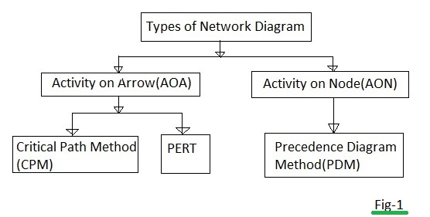
Project Network Design Techniques
Activity on Arrow (AoA) Method:
  Activities represented as arrows, events represented as nodes.
  Arrows indicate task dependencies.
Activities on Node (AoN) Method:
  Activities represented as nodes, events represented as arrows.
  Nodes represent tasks, arrows represent dependencies.
Comparative Analysis of AoA and AoN:
  Choose method based on project complexity and team familiarity.
  AoN is more widely used due to its simplicity and clarity.
Harshit Thakur Unit_4

Slide 31
Network Design Techniques: Activity on Arrow (AoA)
The Activity on Arrow (AoA) method is a network diagramming technique used in project management to represent the sequence of activities in a project and their dependencies. In AoA, activities are represented by arrows, and nodes (or circles) represent events or points in time where the status of the project is reviewed.
Components and steps involved in the Activity on Arrow method in software project management:
Components of AoA Method:
Nodes (Events): Represent specific points in time where an activity starts or ends. They are usually depicted as circles or nodes in the network diagram.
Arrows (Activities): Represent the tasks or activities to be performed. The arrows indicate the direction of the activity and its dependencies.
Duration: The time it takes to complete an activity. It's often represented along the arrows connecting the nodes.
Dependencies: Relationships between activities. Activities often depend on the completion of other activities before they can start.
Harshit Thakur Unit_4

Slide 32
Network Design Techniques: Steps to Create an AoA Diagram
Identify Activities: List down all the tasks or activities that need to be completed for the project. Be specific and detailed about each task.
Determine Dependencies: Determine the sequence in which the activities need to be performed. Some tasks might be dependent on the completion of others.
Draw Nodes: Represent the events or milestones as nodes on the diagram. These nodes represent the start and end points of activities.
Draw Arrows: Connect the nodes with arrows to represent the activities. The direction of the arrow indicates the flow of the activity, from start to end.
Assign Durations: Estimate the time required to complete each activity and represent it along the corresponding arrows.
Critical Path: Identify the critical path, which is the longest sequence of activities that must be completed on time for the project to finish as scheduled. Activities on the critical path have no slack or float time.
Review and Update: Regularly update the AoA diagram as the project progresses. Adjust durations and dependencies based on the actual progress of the project.
Harshit Thakur Unit_4

Slide 33
Network Design Techniques: Advantages and Limitations
Advantages of AoA Method:
Clarity: AoA diagrams provide a clear visual representation of project activities and their relationships.
Dependency Management: Helps in identifying and managing dependencies between tasks.
Critical Path Analysis: Enables the identification of critical tasks that directly impact project completion time.
Resource Allocation: Assists in efficient allocation of resources by understanding the sequence of tasks.
Project Monitoring: Provides a basis for tracking the progress of the project against the planned schedule.
Limitations of AoA Method:
Complexity: For large and complex projects, AoA diagrams can become intricate and difficult to manage.
Limited Information: AoA diagrams do not show resource constraints or resource availability, which can be crucial for project management.
Static Nature: Changes in project scope or requirements may require significant modifications to the AoA diagram.
Not Suitable for Agile Projects: Agile methodologies, which emphasize adaptability and change, may not align well with the rigid structure of AoA diagrams.
Harshit Thakur Unit_4

Slide 34
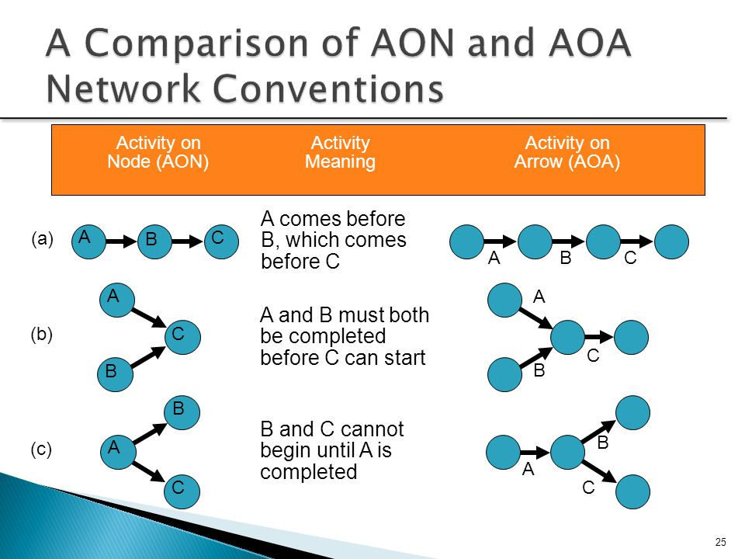
Network Design Techniques
Harshit Thakur Unit_4

Slide 35
Network Design Techniques: Activity on Node (AoN)
The Activity on Node (AoN) method is another network diagramming technique used in project management to represent the sequence of activities in a project. In AoN, activities are represented by nodes (or boxes), and arrows between the nodes represent the dependencies between the activities.
Components of AoN Method:
Nodes (Activities): Represent specific tasks or activities that need to be completed. These are usually depicted as boxes or nodes in the network diagram.
Arrows (Dependencies): Represent the relationships or dependencies between activities. Arrows indicate the sequence in which the activities need to be performed. An arrow points from the predecessor activity to the successor activity.
Duration: The time it takes to complete each activity. This can be represented along the arrows connecting the nodes.
Harshit Thakur Unit_4

Slide 36
Network Design Techniques: Steps to Create an AoN Diagram
Identify Activities: List down all the tasks or activities that need to be completed for the project. Be specific and detailed about each task.
Determine Dependencies: Determine the sequence in which the activities need to be performed. Define which tasks are dependent on the completion of others.
Draw Nodes: Represent the activities as nodes on the diagram. Each node represents a specific task.
Draw Arrows: Connect the nodes with arrows to represent the dependencies between activities. The direction of the arrow indicates the flow of the activity, from start to end.
Assign Durations: Estimate the time required to complete each activity and represent it along the corresponding arrows.
Critical Path: Identify the critical path, which is the longest sequence of activities that must be completed on time for the project to finish as scheduled. Activities on the critical path have no slack or float time.
Review and Update: Regularly update the AoN diagram as the project progresses. Adjust durations and dependencies based on the actual progress of the project.
Harshit Thakur Unit_4

Slide 37
Network Design Techniques: Advantages and Limitations
Advantages of AoN Method:
Clarity: AoN diagrams provide a clear visual representation of project activities and their relationships.
Dependency Management: Helps in identifying and managing dependencies between tasks.
Critical Path Analysis: Enables the identification of critical tasks that directly impact project completion time.
Resource Allocation: Assists in efficient allocation of resources by understanding the sequence of tasks.
Project Monitoring: Provides a basis for tracking the progress of the project against the planned schedule.
Limitations of AoN Method:
Complexity: For large and complex projects, AoN diagrams can become intricate and difficult to manage.
Limited Information: AoN diagrams do not show resource constraints or resource availability, which can be crucial for project management.
Static Nature: Changes in project scope or requirements may require significant modifications to the AoN diagram.
Not Suitable for Agile Projects: Agile methodologies, which emphasize adaptability and change, may not align well with the rigid structure of AoN diagrams.
Harshit Thakur Unit_4

Slide 38
PERT and CPM Techniques
Explanation of PERT:
  Program Evaluation and Review Technique.
  Estimates task duration using optimistic, most likely, and pessimistic values to calculate expected duration.
Explanation of CPM:
  Critical Path Method.
  Identifies the longest sequence of tasks, determining the minimum time to complete the project.
Identifying Critical Path:
  Critical path comprises tasks with no slack, indicating the shortest time to complete the project.
Harshit Thakur Unit_4

Slide 39
PERT
Program Evaluation and Review Technique (PERT) is a project management method that emphasizes the analysis and management of uncertain or ambiguous activities. PERT is particularly useful in software project management where there is often a high degree of uncertainty regarding the time it takes to complete tasks due to the complexity of software development. PERT is a probabilistic approach that allows project managers to handle uncertainty by estimating the duration of tasks as a range of possible values rather than a single fixed value.
Components of PERT:
Optimistic Time (O): The best-case scenario, representing the minimum time required to complete an activity considering the most favorable conditions.
Pessimistic Time (P): The worst-case scenario, representing the maximum time required to complete an activity considering the most unfavorable conditions.
Most Likely Time (M): The best estimate of the time required to complete an activity under normal conditions.
PERT Formulae:
Expected Time (TE):
TE=(O+4M+P)/6
Variance (Var):
Var=[(P−O)/6]2
Standard Deviation (SD):
SD=Var​
Harshit Thakur Unit_4

Slide 40
Steps to Implement PERT in Software Project Management:
Identify Activities: List down all the tasks or activities that need to be completed for the project.
Estimate Time: For each activity, gather input from team members and experts to determine the optimistic (O), pessimistic (P), and most likely (M) time estimates.
Calculate Expected Time: Use the PERT formula to calculate the expected time for each activity.
Calculate Variance and Standard Deviation: Calculate the variance and standard deviation to understand the degree of uncertainty associated with each activity.
Identify Critical Path: Determine the critical path by identifying the longest sequence of activities that must be completed on time to ensure the project's timely completion. Activities on the critical path are those with the longest expected duration.
Probability Analysis: Use the standard deviation and expected time to calculate the probability of completing the project within a specific timeframe. This helps in risk management and planning.
Regular Monitoring and Updating: Continuously monitor the project's progress, update time estimates based on the actual performance, and recalculate the critical path and project completion probabilities as the project progresses.
Harshit Thakur Unit_4

Slide 41
Example
Let's consider a simple software development project involving three major tasks: Requirements Gathering (A), Development (B), and Testing (C).
For the sake of this example, we'll assume the following time estimates in weeks for each task:
Optimistic Time (O): Best-case scenario time for completion.
Pessimistic Time (P): Worst-case scenario time for completion.
Most Likely Time (M): Best estimate of the time required under normal conditions.
Task A (Requirements Gathering):
OA​=2 weeks
PA​=4 weeks
MA​=3 weeks
Task B (Development):
OB​=3 weeks
PB​=6 weeks
MB​=4 weeks
Task C (Testing):
OC​=1 week
PC​=2 weeks
MC​=1.5 weeks
Calculations using PERT Formulae:
Expected Time (TE):
TEA​=(2+4+3)/6=3 weeks TEB​=(3+6+4)/6=4.5 weeks TEC​=(1+2+1.5)/6=1.58 weeks
Variance (Var):
VarA​=[(4−2)/6]2=0.11
VarB​=[(6−3)/6]2=0.25
VarC​=[(2−1)/6]2=0.03
Standard Deviation (SD):
SDA​=0.11​≈0.33 weeks
SDB​=0.25​=0.5 weeks
SDC​=0.03​≈0.17 weeks
Harshit Thakur Unit_4

Slide 42
PERT
Critical Path and Project Duration:
Critical Path: The critical path consists of the sequence of tasks with the longest expected duration. In this case, the critical path includes tasks A (Requirements Gathering), B (Development), and C (Testing).
Project Duration: The expected time for the critical path tasks represents the expected duration of the project.
ProjectDuration=TEA​+TEB​+TEC​=3 +4.5 +1.58 =9.08
ProjectDuration=3weeks+4.5weeks+1.58weeks=9.08weeks
Using PERT, the project manager can estimate that the software development project is expected to be completed in approximately 9 weeks. Additionally, the standard deviations calculated for each task can be used for probability analysis and risk management to assess the likelihood of completing the project within specific timeframes
Harshit Thakur Unit_4

Slide 43
PERT
Advantages of PERT in Software Project Management:
Handling Uncertainty: PERT allows for the management of uncertainty in project schedules, which is common in software development due to the dynamic nature of the work.
Probability Analysis: Provides a probability distribution for project completion, helping in risk assessment and decision-making.
Focus on Critical Activities: Helps project managers focus their attention on critical activities that have the most significant impact on the project's overall schedule.
Resource Optimization: Allows for better allocation of resources by understanding the timeframes in which they are needed the most.
Limitations of PERT in Software Project Management:
Complexity: PERT involves complex calculations, especially when dealing with a large number of activities, which might require specialized software tools.
Assumption of Independence: PERT assumes that activities are independent, which might not be the case in real-world software projects where dependencies are common.
Expertise Required: Accurate estimation of optimistic, pessimistic, and most likely times requires expertise and experience, which might be challenging to obtain.
Dynamic Projects: PERT might not be well-suited for highly dynamic projects, especially those following agile methodologies, where requirements and tasks can change frequently.
Harshit Thakur Unit_4

Slide 44
CPM
CPM stands for Critical Path Method, which is a project management technique used to determine the longest sequence of dependent tasks and activities required to complete a project. The critical path represents the shortest time in which the project can be completed, as any delay in tasks along the critical path will directly impact the project's overall duration.
Here's how the Critical Path Method works:
1. Identify Tasks and Dependencies: List all the tasks and activities required to complete the project. Determine the dependencies between tasks, such as finish-to-start, start-to-start, finish-to-finish, and start-to-finish relationships.
2. Estimate Task Durations: Estimate the duration required to complete each task. This can be done using historical data, expert judgment, or other estimation techniques.
3. Construct a Network Diagram: Use the task list and dependencies to create a network diagram, also known as a precedence diagram or activity-on-node (AON) diagram. Tasks are represented as nodes, and dependencies are represented as arrows connecting the nodes.
4. Calculate Early Start (ES) and Early Finish (EF) Times: Starting from the first task, calculate the earliest start time (ES) and earliest finish time (EF) for each task based on its duration and the dependencies.
Harshit Thakur Unit_4

Slide 45
CPM
5. Calculate Late Start (LS) and Late Finish (LF) Times: Starting from the last task, calculate the latest start time (LS) and latest finish time (LF) for each task, working backward through the network. This helps identify the latest possible start time for each task without delaying the project.
6. Identify the Critical Path: The critical path is the longest path through the network, where the total duration equals the sum of the durations of tasks on that path. Tasks on the critical path have zero slack or float, meaning any delay in these tasks will directly impact the project's overall duration.
7. Analyze Slack or Float: Tasks that are not on the critical path have slack or float, which represents the amount of time that a task can be delayed without delaying the project. This allows project managers to identify tasks that have flexibility in their scheduling.
8. Monitor and Manage the Critical Path: Continuously monitor the tasks on the critical path and manage them closely to ensure they are completed on time. Any delays in critical path tasks should be addressed promptly to prevent delays in the overall project schedule.
Harshit Thakur Unit_4

Slide 46
Project Crashing
Identifying Critical Path for Crashing:
  Critical path tasks have no slack and are crucial for project completion time.
  Identify tasks on the critical path.
Crashing Techniques and Considerations:
  Allocate additional resources to critical tasks to shorten their duration.
  Consider cost implications of crashing.
Cost-Benefit Analysis of Crashing:
  Determine if the cost of crashing is justified by the time saved.
  Evaluate the impact on project budget and resources.
Harshit Thakur Unit_4
Notes:
https://www.youtube.com/watch?v=6Qj9RNXTJ4Q

Slide 47
Project Crashing
Crashing in software project management refers to a specific technique used to shorten the duration of a project by adding more resources to it. The idea is to throw additional resources (such as personnel, equipment, or funds) at critical tasks to reduce their duration and, consequently, the overall project duration. Crashing is often used when a project is behind schedule and needs to be completed as quickly as possible.
Here are the key points to understand about crashing in software project management:
How Crashing Works:
Identify Critical Path: The critical path in a project is the sequence of tasks that determines the project's duration. These tasks have no slack or float time, meaning any delay in these tasks will directly impact the project's completion time.
Determine Critical Tasks: Identify the tasks on the critical path that, if completed faster, will reduce the project duration.
Add Resources: Allocate additional resources to critical tasks to speed up their completion. This can involve adding more skilled personnel, using more powerful equipment, or investing in overtime work.
Shorten Task Durations: By adding more resources, the time required to complete critical tasks can be shortened. However, this often comes at an increased cost due to overtime pay, expedited shipping costs, or other expenses related to expediting tasks.
Monitor Progress: Continuously monitor the progress of the project to ensure that the additional resources are utilized effectively and the tasks are completed faster.
Harshit Thakur Unit_4
Notes:
https://www.youtube.com/watch?v=6Qj9RNXTJ4Q

Slide 48
Example
Crashing the Project: To meet the client's deadline, the project manager decides to crash the project schedule. The project manager evaluates the critical tasks and determines that both frontend and backend development tasks can be accelerated by adding more skilled developers to the team. The testing task cannot be accelerated without compromising the quality, so it remains unchanged.
Initial Project Schedule (24 Weeks):
Task A (Frontend Development): 8 weeks (Weeks 1-8)
Task B (Backend Development): 10 weeks (Weeks 1-10)
Task C (Testing and QA): 6 weeks (Weeks 15-20)
Crashed Project Schedule (20 Weeks):
Task A (Frontend Development): 6 weeks (Weeks 1-6) - Crashed by 2 weeks
Task B (Backend Development): 8 weeks (Weeks 1-8) - Crashed by 2 weeks
Task C (Testing and QA): 6 weeks (Weeks 13-18) - Remains the same
example to illustrate the concept of crashing in a software project management scenario.
Project Background: Imagine a software development project where a team is building an e-commerce website for a client. The project involves multiple tasks, but the critical path tasks are:
Task A: Frontend Development (Estimated duration: 8 weeks)
Task B: Backend Development (Estimated duration: 10 weeks)
Task C: Testing and QA (Estimated duration: 6 weeks)
The total estimated project duration, based on these critical tasks, is 24 weeks (8 weeks + 10 weeks + 6 weeks).
Client Requirement: The client has an urgent business need to launch the e-commerce website in 20 weeks instead of 24 weeks.
Harshit Thakur Unit_4
Notes:
https://www.youtube.com/watch?v=6Qj9RNXTJ4Q

Slide 49
Project Crashing
Crashing Actions Taken:
Task A (Frontend Development): Two additional experienced frontend developers are added to the team, doubling the workforce to expedite the development process.
Task B (Backend Development): Two skilled backend developers are hired, increasing the workforce and expediting the backend development phase.
Result: With the crashing actions implemented, the project schedule is reduced to 20 weeks:
Task A (Frontend Development): 6 weeks (Weeks 1-6)
Task B (Backend Development): 8 weeks (Weeks 1-8)
Task C (Testing and QA): 6 weeks (Weeks 13-18)
By adding more skilled developers to the frontend and backend tasks, the project can meet the client's deadline of 20 weeks. However, it's important to note that this acceleration comes at an increased cost due to the additional resources. Team coordination, effective communication, and close monitoring of the tasks are essential to ensure the crashing technique is applied successfully without compromising the quality of the project deliverables.
Harshit Thakur Unit_4
Notes:
https://www.youtube.com/watch?v=6Qj9RNXTJ4Q

Slide 50
Best Practices
Effective Project Scheduling and Network Design Best Practices:
  Involve all stakeholders in the planning process.
  Use reliable estimation techniques.
  Regularly update the project schedule based on progress and changes.
Real-life Examples of Successful Projects:
  Provide examples of projects that benefitted from efficient scheduling and network analysis.
  Highlight strategies that led to their success.
Harshit Thakur Unit_4
Notes:
https://www.youtube.com/watch?v=6Qj9RNXTJ4Q

Slide 51
Conclusion
Summary of Key Points:
  Project scheduling and network analysis are fundamental to project management.
  Proper planning ensures timely completion, resource optimization, and project success.
Importance of Efficient Project Scheduling:
  Efficient scheduling is essential for project success.
  It minimizes risks, enhances collaboration, and ensures project goals are achieved.
Q&A Session:
  Invite the audience to ask questions about project scheduling and network analysis
Harshit Thakur Unit_4
Notes:
https://www.youtube.com/watch?v=6Qj9RNXTJ4Q

Slide 52
Multiple Choice Questions
Which of the following is a primary objective of project scheduling? A. Budgeting B. Defining Scope C. Timely Completion D. Risk Management Answer: C
What does WBS stand for in project management? A. Work Breakdown Structure B. Work Base System C. Work Budgeting Schedule D. Workflow Building Strategy Answer: A
In project management, which task dependency type states that Task B cannot finish until Task A starts? A. Finish-to-Start B. Start-to-Start C. Finish-to-Finish D. Start-to-Finish Answer: B
What is the purpose of a Gantt chart in project management? A. Resource Allocation B. Task Sequencing C. Time Visualization D. Risk Assessment Answer: C
In the context of network analysis, what does AoA represent? A. Activities as Arrows B. Activities as Nodes C. Events as Arrows D. Events as Nodes Answer: A
Harshit Thakur Unit_4
Notes:
https://www.youtube.com/watch?v=6Qj9RNXTJ4Q

Slide 53
True/False Questions
The critical path in a project network is the shortest path from start to finish. Answer: True
Crashing a project refers to extending the project schedule to accommodate additional tasks. Answer: False
PERT uses only one estimate to calculate task duration. Answer: False
The Responsibility Assignment Matrix (RAM) defines the project schedule. Answer: False
Work Breakdown Structure (WBS) is created after task sequencing. Answer: False
Harshit Thakur Unit_4
Notes:
https://www.youtube.com/watch?v=6Qj9RNXTJ4Q

Slide 54
Fill in the Blank
A ____________ is a visual representation of the project schedule, showing tasks against time. Answer: Gantt Chart
____________ involves shortening the project duration by allocating additional resources to critical tasks. Answer: Project Crashing
In the context of task sequencing, FS stands for Finish-to-__________. Answer: Start
____________ is a method of task duration estimation that uses three estimates: optimistic, most likely, and pessimistic. Answer: PERT
The ____________ is the longest sequence of tasks in a project, determining the minimum time to complete the project. Answer: Critical Path
Harshit Thakur Unit_4
Notes:
https://www.youtube.com/watch?v=6Qj9RNXTJ4Q

Slide 55
Short Answer Questions
Explain the importance of task sequencing in project management.
Describe the key components of a Work Breakdown Structure (WBS).
How does crashing affect the project budget? Provide an example.
What is the critical path in a project network, and why is it important?
Explain the concept of Responsibility Assignment Matrix (RAM) in project management.
Harshit Thakur Unit_4
Notes:
https://www.youtube.com/watch?v=6Qj9RNXTJ4Q

Slide 56
Essay Questions
Compare and contrast Activity on Arrow (AoA) and Activities on Node (AoN) methods in project network design.
Discuss the advantages and disadvantages of using PERT (Program Evaluation and Review Technique) in project management.
Explain the concept of project crashing. Provide examples of situations where crashing might be necessary.
Describe the role of Gantt charts in project management. How do they aid in project planning and tracking?
Discuss the challenges associated with resource allocation in project management and strategies to overcome them.
Harshit Thakur Unit_4
Notes:
https://www.youtube.com/watch?v=6Qj9RNXTJ4Q

Slide 57
Case Study Questions
Analyze a hypothetical project scenario and create a Work Breakdown Structure (WBS) for the project tasks.
Given a project network diagram, identify the critical path and explain its significance in the context of the project's timeline.
Evaluate a project scenario and recommend appropriate crashing strategies to meet the project deadline without significantly exceeding the budget.
Examine a real-life project management case study and discuss how effective task sequencing contributed to the project's success or failure.
Review a project schedule represented in a Gantt chart format. Identify potential resource conflicts and propose solutions to resolve them.
Harshit Thakur Unit_4
Notes:
https://www.youtube.com/watch?v=6Qj9RNXTJ4Q

Slide 58
Question on Basics of Project Scheduling and Network Analysis
Define project scheduling and explain its significance in project management.
Describe the steps involved in project scheduling and network design.
Compare and contrast Work Breakdown Structure (WBS) and Responsibility Assignment Matrix (RAM).
Explain the concept of task dependencies in project management. Provide examples of different types of task dependencies.
What is the critical path in project management? How is it determined in a project network?
Harshit Thakur Unit_4
Notes:
https://www.youtube.com/watch?v=6Qj9RNXTJ4Q

Slide 59
Questions on Network Design Methods
Compare and contrast Activity on Arrow (AoA) and Activities on Node (AoN) methods in project network design.
Explain how the Activity on Arrow (AoA) method represents tasks and events in a project network diagram.
Describe the Activities on Node (AoN) method and how it differs from AoA.
Discuss the advantages and disadvantages of using AoA and AoN methods in project planning.
Explain the significance of dummy activities in project network diagrams. Provide an example scenario.
Harshit Thakur Unit_4
Notes:
https://www.youtube.com/watch?v=6Qj9RNXTJ4Q

Slide 60
Questions on PERT and CPM Techniques
Explain the Program Evaluation and Review Technique (PERT) in detail. How is it different from Critical Path Method (CPM)?
Discuss the three time estimates used in PERT (optimistic, most likely, pessimistic) and how they are used to calculate expected task duration.
Explain the concept of the critical path in project management. Why is it important for project managers to identify the critical path?
Describe how the Critical Path Method (CPM) helps in determining the project timeline and task dependencies.
Provide a real-life example where PERT or CPM techniques could be applied effectively in project management.
Harshit Thakur Unit_4
Notes:
https://www.youtube.com/watch?v=6Qj9RNXTJ4Q

Slide 61
Questions on Gantt Charts and Project Visualization
Explain the purpose of Gantt charts in project management. How are they used for project visualization and planning?
Create a hypothetical Gantt chart for a software development project. Include major tasks, start and end dates, and task dependencies.
Discuss the limitations of Gantt charts in representing complex project schedules. What are the alternative visualization methods for complex projects?
Explain how Gantt charts are used in project monitoring and control. What information can project managers derive from a Gantt chart?
Compare traditional Gantt charts with modern, interactive Gantt chart software tools. Highlight the advantages of using interactive Gantt charts.
Harshit Thakur Unit_4
Notes:
https://www.youtube.com/watch?v=6Qj9RNXTJ4Q

Slide 62
Questions on Project Crashing and Resource Optimization
Define project crashing. Under what circumstances might project crashing be necessary? Provide examples.
Explain the concept of resource leveling in project management. How does it help in optimizing resource utilization?
Discuss the challenges associated with resource allocation in project management. How can these challenges be mitigated effectively?
Compare and contrast resource smoothing and resource leveling techniques. When is each technique appropriate to use in project management?
Describe the role of project management software in resource optimization. Provide examples of popular project management tools that facilitate resource management.
Harshit Thakur Unit_4
Notes:
https://www.youtube.com/watch?v=6Qj9RNXTJ4Q

Slide 63
Questions on Case Study and Application
Analyze a real-life project management case study and identify the critical path. Discuss how delays in critical path tasks can impact the project timeline.
Create a network diagram for a construction project with at least ten tasks. Determine the critical path and calculate the project duration.
Investigate a project management failure case and analyze the factors that led to the failure. Suggest alternative strategies that could have prevented the failure.
Interview a project manager or research a project management success story. Discuss the project scheduling and network analysis techniques used in the project's success.
Imagine you are managing a software development project. Create a comprehensive project schedule using both Gantt charts and network diagrams. Include all major tasks, dependencies, and milestones.
Harshit Thakur Unit_4
Notes:
https://www.youtube.com/watch?v=6Qj9RNXTJ4Q

